Slide 1



Slide 2

See my sample access code on github:
https://github.com/PeterSigurdson/MSAccessAssets
USE SUBLIME TEXT EDITOR:
(it gives you sql syntax color coding!)
https://www.sublimetext.com/3

Slide 3
What is the difference between inner join and intersect?
They are not the same but you can get the same result.
Intersect:
Intersect does all columns.
When using INTERSECT operator the number and the order of the columns must be the same in all queries as well data type must be compatible.
Use an intersect operator to returns rows that are in common between two tables; it returns unique rows from both the left and right query.
This query is useful when you want to find results that are in common between two queries.
Inner Join:
Inner join only the specified columns.
An INNER JOIN is a JOIN operation that allows you to specify an explicit join clause.
An inner join attempts to match up the two tables based on the criteria you specify in the query, and only returns the rows that match.
If a row from the first table in the join matches two rows in the second table, then two rows will be returned in the results.
Notes:
https://www.quora.com/What-is-the-difference-between-inner-join-and-intersect

Slide 4
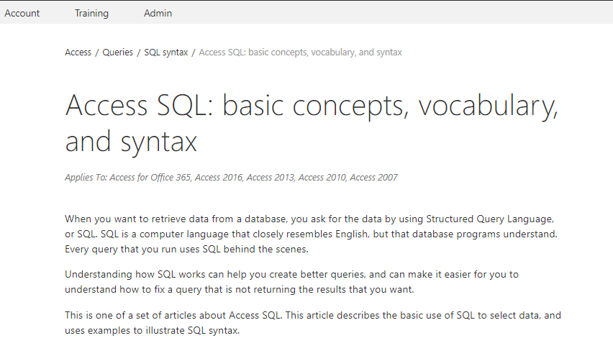
https://support.office.com/en-us/article/access-sql-basic-concepts-vocabulary-and-syntax-444d0303-cde1-424e-9a74-e8dc3e460671

Slide 5
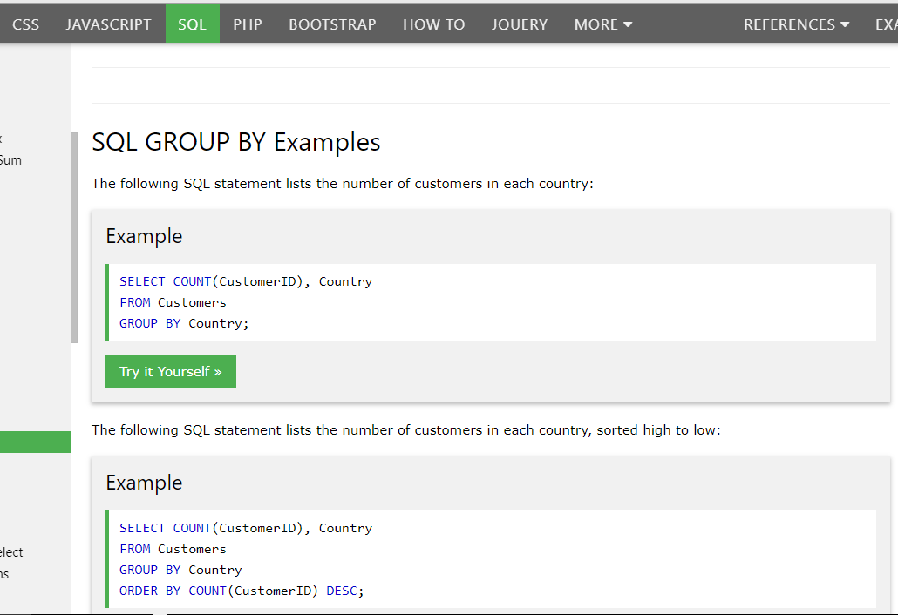

Slide 6
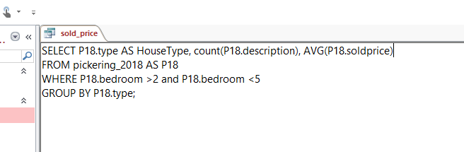
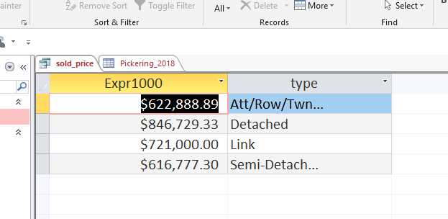
Column Alias, Aggregate Functions, Group By

Slide 7
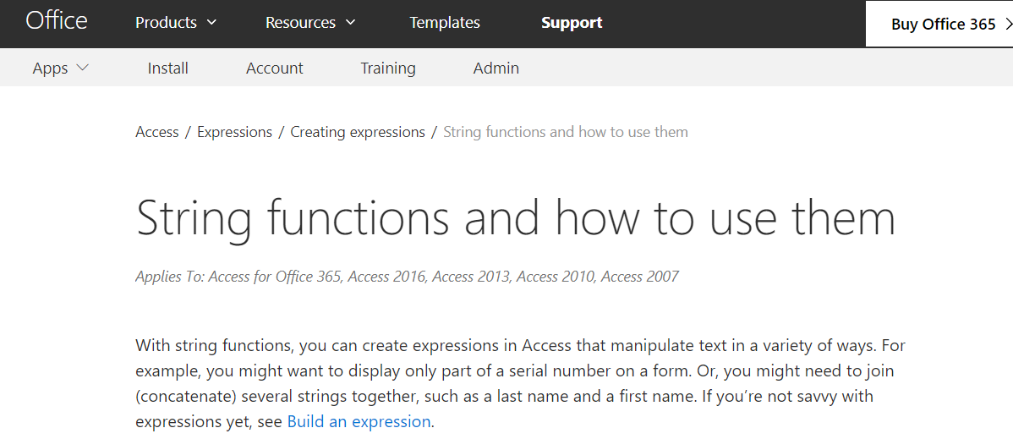
Working with TEXT
https://support.office.com/en-us/article/string-functions-and-how-to-use-them-965efa84-7009-4603-9765-2eb4a099ec72

Slide 8
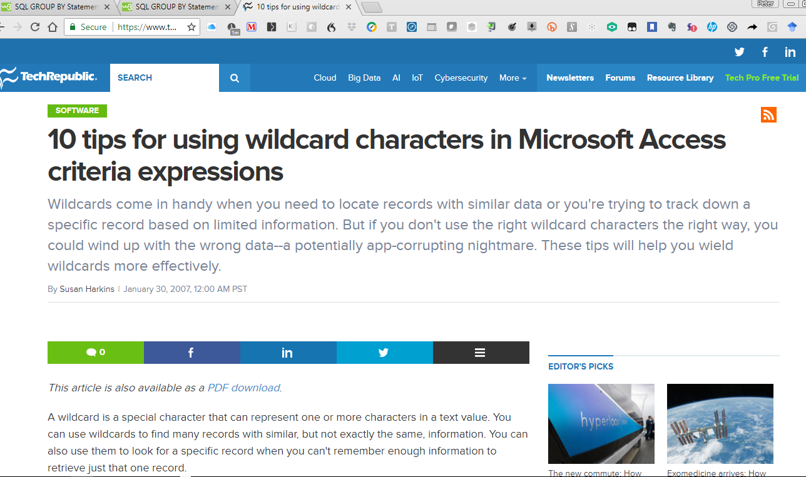
https://www.techrepublic.com/article/10-tips-for-using-wildcard-characters-in-microsoft-access-criteria-expressions/

Slide 9
Developing the bicycle shop database

Slide 10
The requirement
You have been hired by a bicycle repair shop to create a Database to keep track of the details of customers who:
(1) Purchase a Bicycle [and are therefore entitled to free lifetime repairs], and
(2) customers who bring their Bicycle in to be repaired (for a $25/hour fee + cost of parts).
The Database Shall provide a data structure to store: customer information, bicycle information, and any other relator tables you need to put into your design to make the SQL relationships work

Slide 11
The requirement
Sketch the design for your Relational Database system with the necessary tables to make the above-stated requirement work.
State all fields in each table: Field Data types must be specified correctly.
Remember to identify your Primary keys.

Slide 12

Some important points
Remember that for Bicycle Repairs, you must state whether the Repair is WARRENTY or BILLABLE.
People who bought a bicycle from the shop have free lifetime repairs. Walk In Customers are charged $25/hour.
You will have to use LEFT, RIGHT, INNER and OUTER joins in the course of getting all your work done.

Slide 13

Deliverable requirements
A Microsoft Access Database with data-populated tables
You might find it easier to write the data in the form of spreadsheets and import it
Write 3 SQL Statements:
Generate a Report on all customers including bicycles they have purchased or brought in for repair
Generate a Report on all Bicycles purchased or brought in for repair.
Generate a Report on the activities of the Repair Department: How many bicycles they have repaired, time spent, and revenue generated

Slide 14
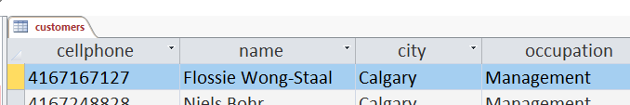
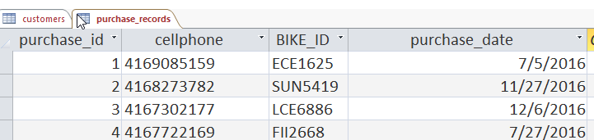
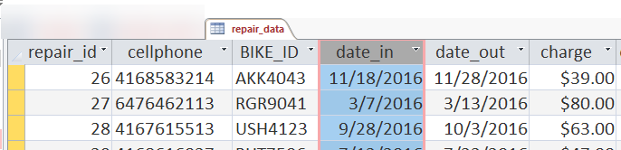
Deliverable requirements
Your database must have (at least) these tables and fields for my automated tests to work: [You may need more tables to meet the requirements of the Client]

Slide 15
Project delivery notes:
You will be using your class time for Weeks 11, 12, and 13
On Week 14 we will do Test 2 in class. The contents of Test 2 will mirror very closely the skills of the Project.
We will be spending some time in class to learn some additional SQL Formulations:
Group By and HAVING
Aggregation Functions
Inner, outer, left and right joins

Slide 16
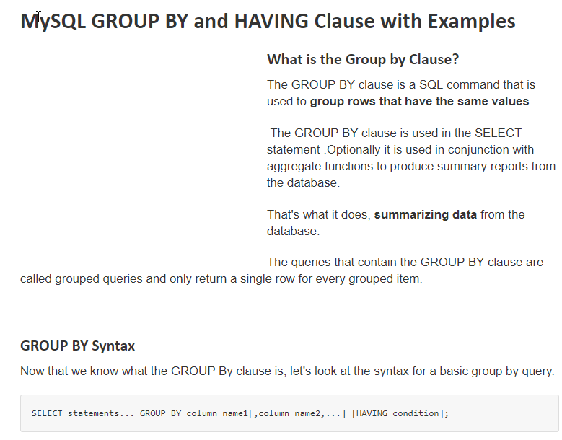
Notes:
https://www.guru99.com/group-by.html

Slide 17


Slide 18
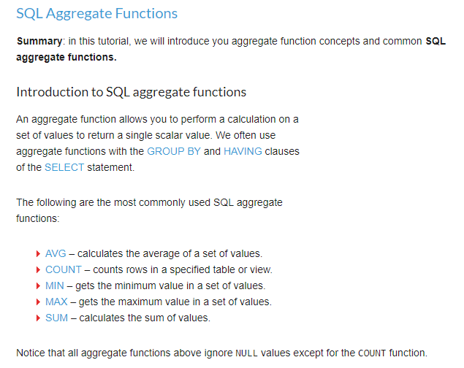
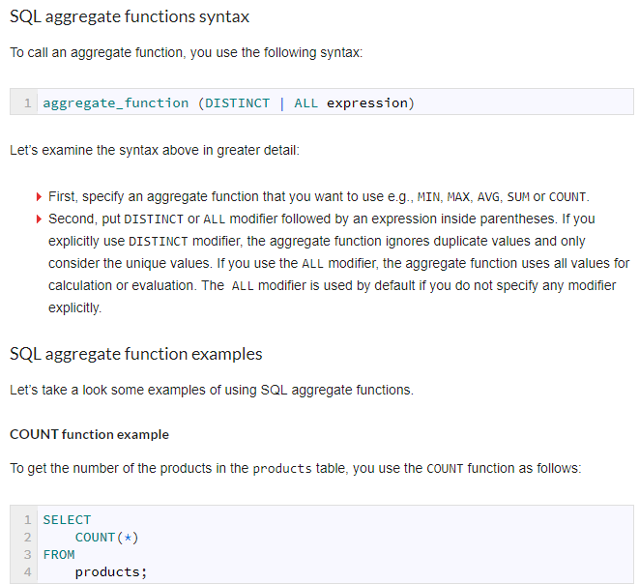
http://www.zentut.com/sql-tutorial/sql-aggregate-functions/

Slide 19
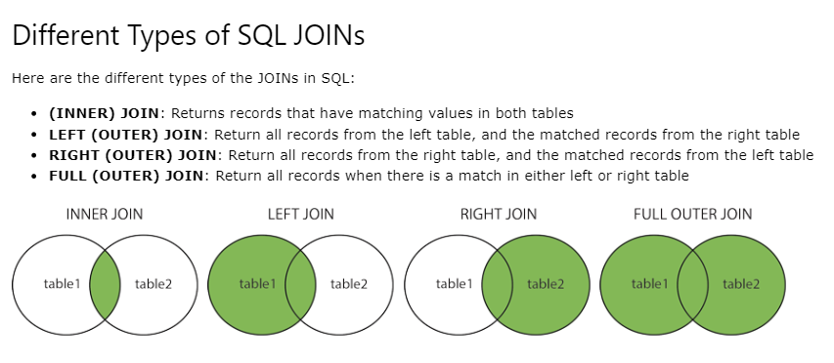

Slide 20
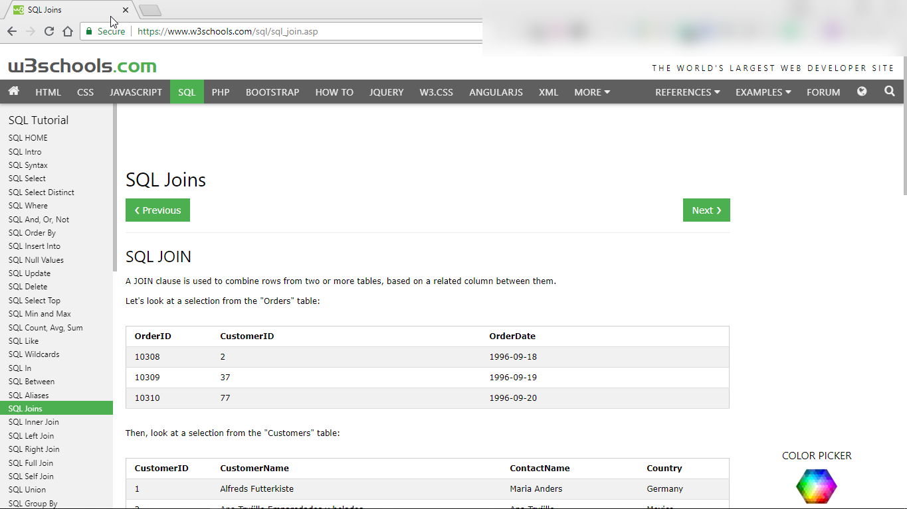

Slide 21
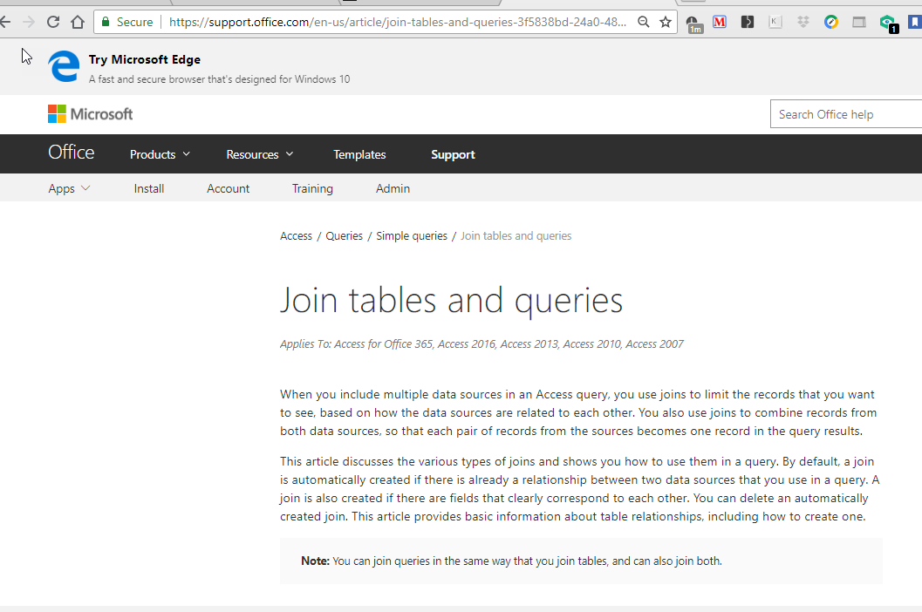
https://support.office.com/en-us/article/join-tables-and-queries-3f5838bd-24a0-4832-9bc1-07061a1478f6

Slide 22
WORKSHEET FOR DATABASE PROJECT DELIVERABLE:
Write 3 SQL Statements:
Generate a Report on all customers including bicycles they have purchases or brought in for repair: LEFT_JOIN_2
SELECT c.cellphone, c.name, c.city, c.occupation, p.cellphone,
p.bicycle_id_number, p.purchase_date, r.date_in, r.charge, r.cellphone
FROM ( ( customers AS c )
LEFT JOIN purchase_records AS p ON c.cellphone = p.cellphone )
LEFT JOIN repair_data AS r ON c.cellphone = r.cellphone

Slide 23
WORKSHEET FOR DATABASE PROJECT DELIVERABLE:
Write 3 SQL Statements:
Generate a Report on all Bicycles purchased or brought in for repair:
INCLUDING THE REPAIR DETAILS AND THE CUSTOMER DETAILS.
What 2 things will you need to do to make this happen?
Have a BICYCLES Table as the CONTROLLER Table.
Do Left Joins on the BICYCLES TABLE to both Purchases and Repairs.
This is your Exercise to do for the Assignment.

Slide 24
WORKSHEET FOR DATABASE PROJECT DELIVERABLE:
Write 3 SQL Statements: ‘REPAIR_DEPARTMENT_ACTIVITIES’
Generate a Report on the activities of the Repair Department: How many bicycles they have repaired, time spent, and revenue generated.
How will you know to report ZERO DOLLARS for repairs done when the bicycle was purchased at our Shop?
WE WILL NEED TO DO THIS AS A LEFT JOIN: COMPLETE THE DETAILS HERE BASED ON YOUR PREVIOUS WORK:

Slide 25
USING THIS TEMPLATE, COMPLETE THE SQL CODE TO DO THE LEFT JOIN OF REPAIR DATA WITH PURCHASE RECORDS:
SELECT customers.name, purchase_records.purchase_date
FROM customers
LEFT JOIN purchase_records ON customers.cellphone = purchase_records.cellphone;

Slide 26
SELECT c.cellphone, c.name, c.city, c.occupation, p.cellphone, p.bicycle_id_number, p.purchase_date, r.date_in, r.charge, r.cellphone
FROM (customers AS c LEFT JOIN purchase_records AS p
ON c.cellphone = p.cellphone)
LEFT JOIN repair_data AS r ON c.cellphone = r.cellphone;

Slide 27
SELECT CategoryName,
ProductName
FROM Categories LEFT JOIN Products
ON Categories.CategoryID = Products.CategoryID;

Slide 28
How to create a New Table from a SQL Query
SELECT a,b,c INTO NewTable
FROM
(SELECT a,b,c
FROM TheTable
WHERE a Is Null)

Slide 29
We have created a new table called aaa.
We can now do a query on this Table to SUM the repair costs for records for which the Purchase Date is NULL – that is, for bicycles which were not purchased from our store.
SELECT sum(aaa.charge) as Revenue, count(aaa.charge) as NumberCustomers, customers.city
FROM aaa, customers
where customers.cellphone = aaa.cellphone
group by city
Notes:
Query_table_aaa

Slide 30
Repair data report
SELECT repair_data.cellphone,
purchase_records. purchase_date, repair_data.charge, repair_data.bike_id, repair_data.date_out
FROM repair_data
LEFT JOIN purchase_records
ON repair_data.cellphone = purchase_records.cellphone

Slide 31
Write 3 SQL Statements:
Generate a Report on the activities of the Repair Department: How many bicycles they have repaired, time spent, and revenue generated
Two approaches are available:
Create an Intermediate Results Table and do further processing on it.
Do a Correlated Sub Query.

Slide 32
See my sample access code on github:
https://github.com/PeterSigurdson/MSAccessAssets
USE SUBLIME TEXT EDITOR:
(it gives you sql syntax color coding!)
https://www.sublimetext.com/3

